Slide 2
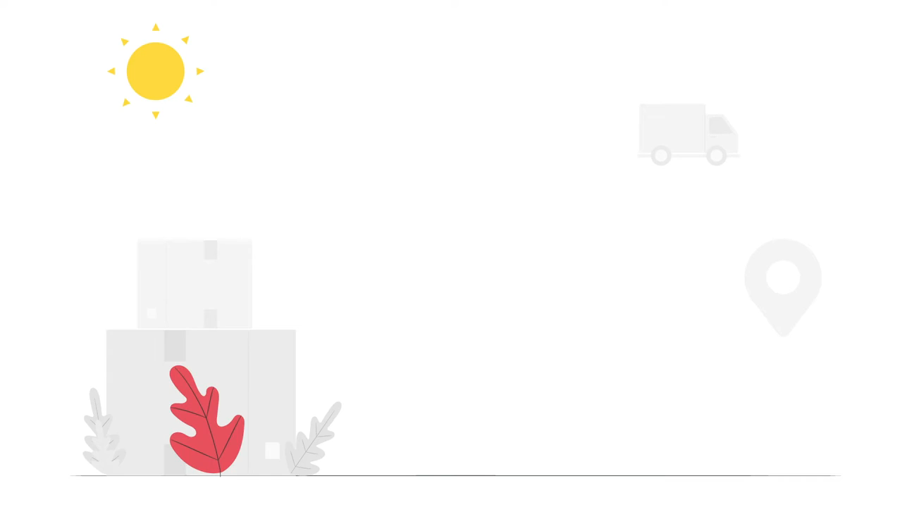

Online Vegan Food Delivery System
Online Vegan Food Delivery System
Submitted to:
Department of Computer Science and Engineering

Slide 3
Supervised by: Prof. Praveen Bhanodia
Team Members
1.Mahak Chittoda(0827CS191141)
2.Neelesh Vaishnav(0827CS191164)
3.Palash Jain(0827CS191169)
4.Purvi Parashar(0827CS191181)

Slide 4
Project Presentation Outline
Abstract
Objectives
Introduction
Requirement analysis
Problem statement
Solution Proposed
Survey of existing system
Outcomes and limitations

Slide 5
Abstract
The system proposed here signifies Vegan food delivery process .This system will allow restaurants to quickly and easily manage an online menu which customers can browse and use to place orders with just a few clicks. The system then relays these orders to restaurant’s employees through an easy to navigate graphical interface for efficient processing.

Slide 6
Introduction
The food industry is highly labour intensive and the biggest expense in the food industry is the cost of employing the right kind of people to do the work.
One of the ways to reduce this expense is to use modern technology to replace some of the jobs done by human beings and make machines do the work. Here we propose an “Online Vegan Food Delivery System”.
Through this website one can order various variety of vegan food from some local restaurant and hotels through the use of internet, just by sitting at home or any place.

Slide 7
The Problem Statement
Many Restaurants are storing all their data in manual way. They have huge number of customers daily. So because larger number of customers, they need the help of some features so they can maintain and stores the data accurately.
They need full-fledged software to maintain their day to day transactions, orders and also regular update on records, cash transaction, daily staff reports, customers feedback etc.

Slide 8
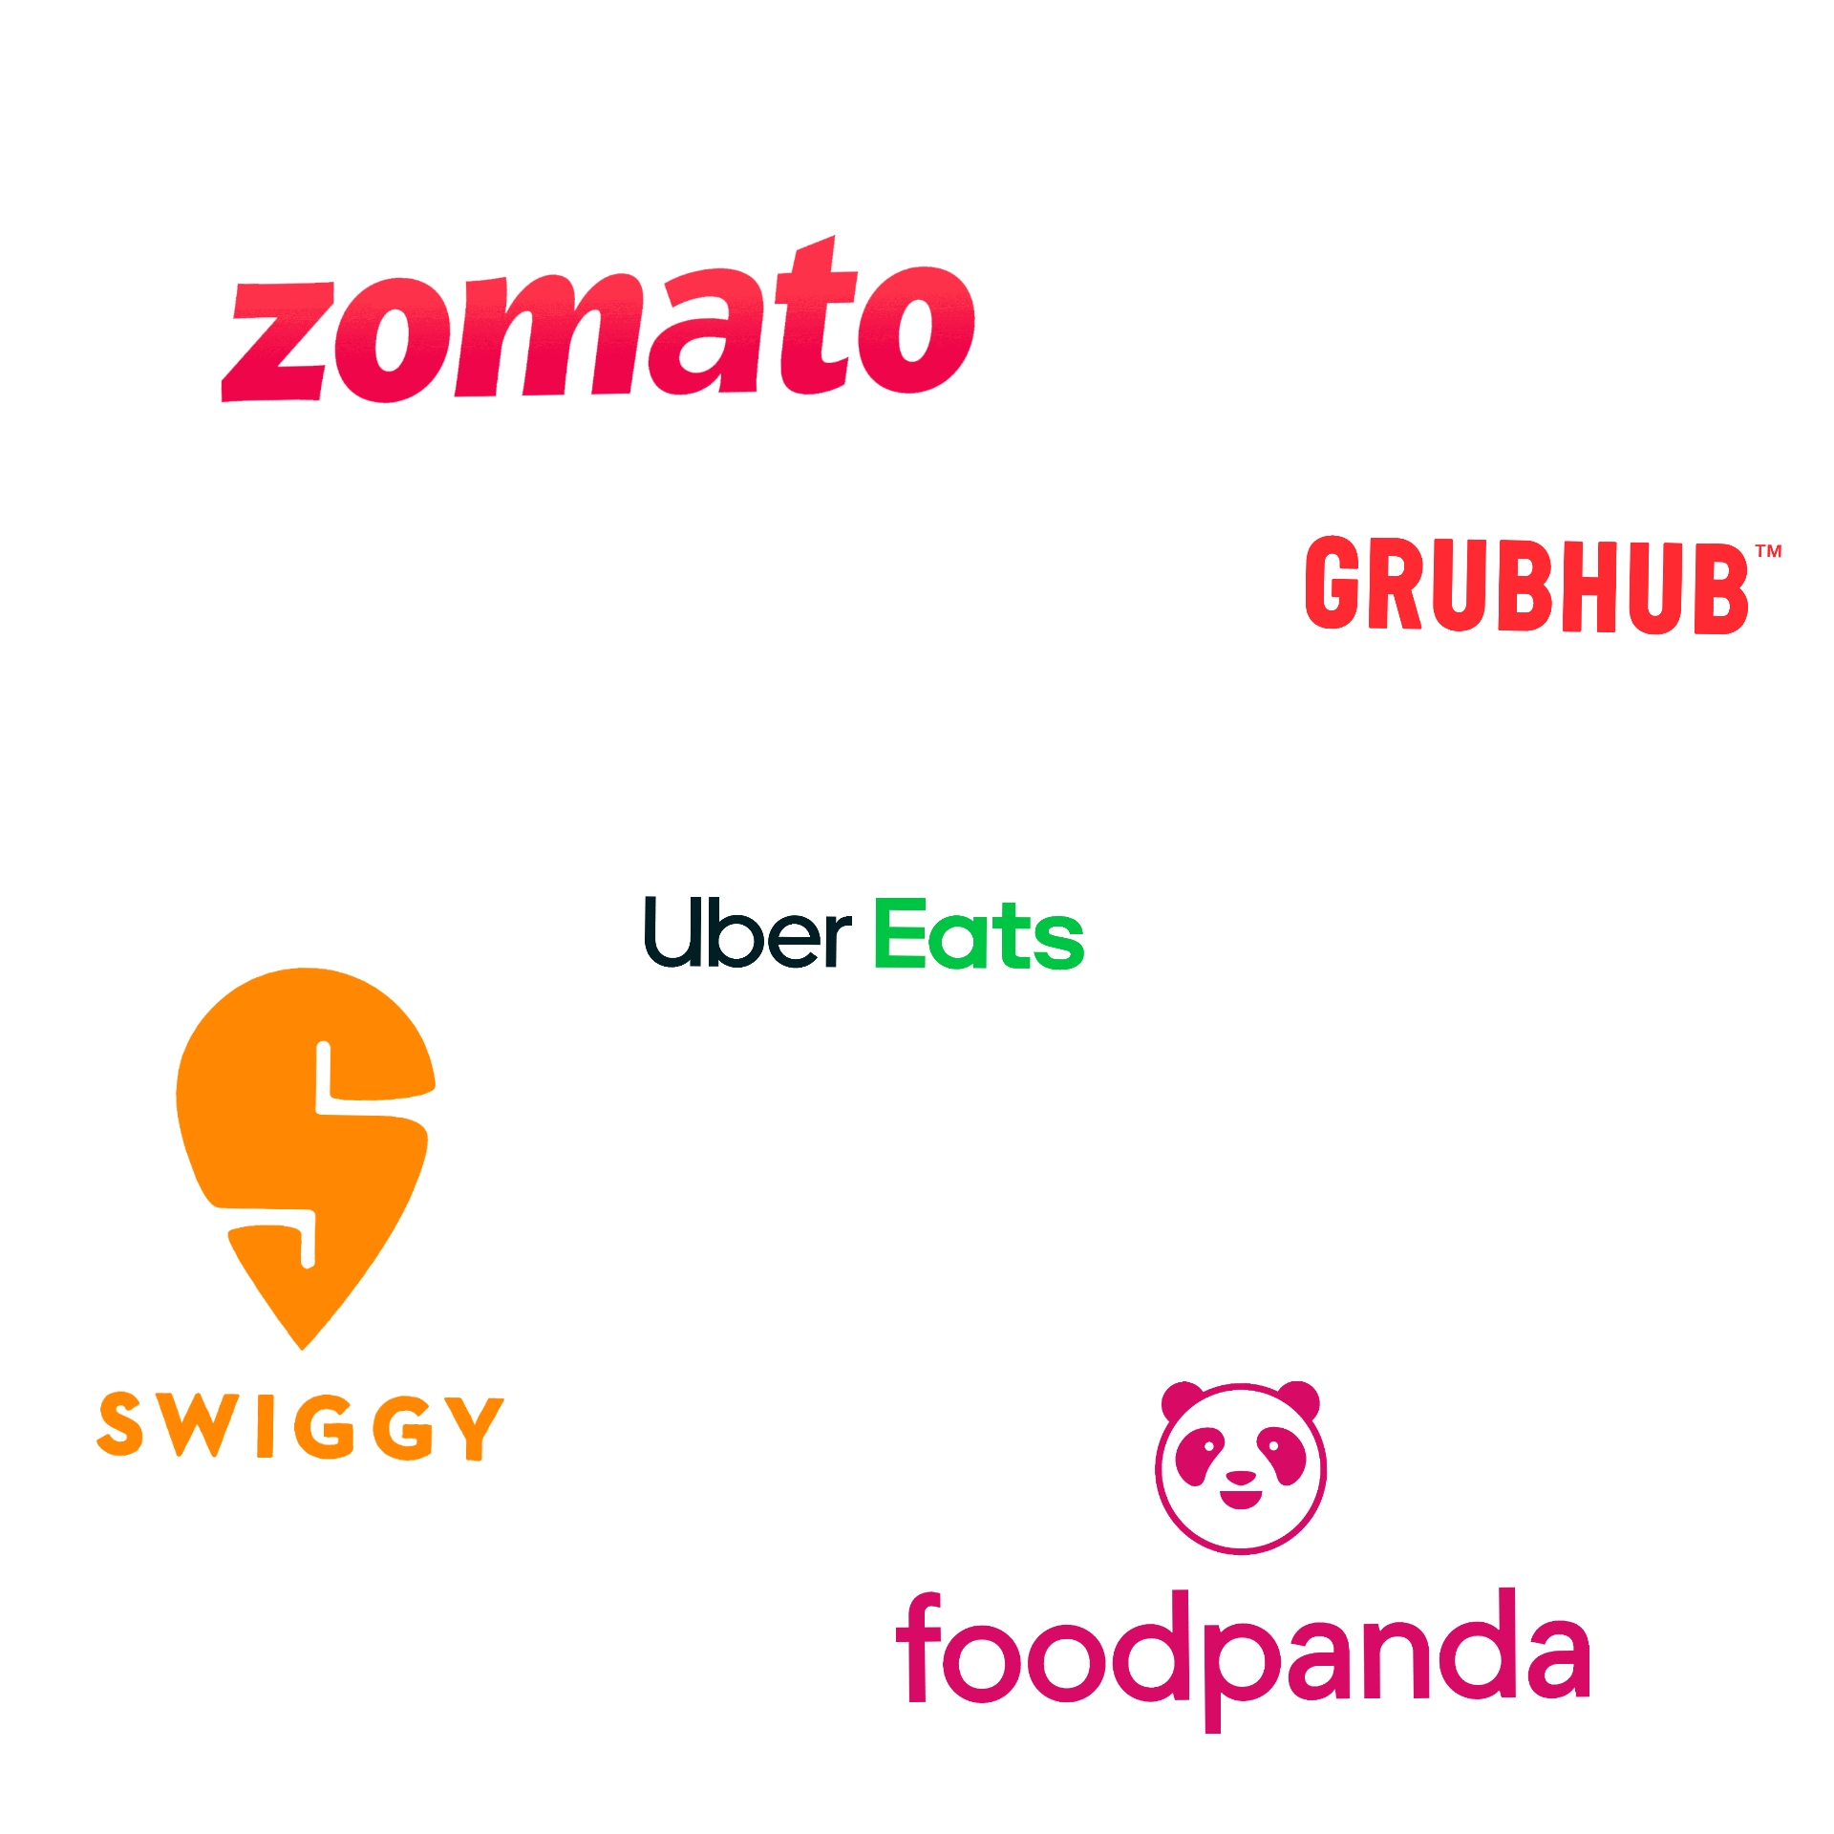
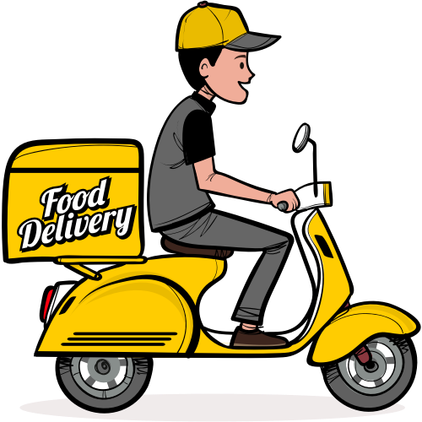
Survey of Existing Systems

Slide 9

Swiggy
Swiggy was founded in 2014. This is the biggest online food ordering application which delivers food in several cities.
Advantages of Swiggy:
Customer Service is Top Priority
More popularity
Disadvantages of Swiggy:
Lack of information
Lack of images
Traffic Generation

Slide 10

Zomato
Zomato was started as foodieway in 2008.Zomato came up with the idea of dining and ordering food to make easier for people to explore various hotels and restaurants.
Advantages:
Table Booking
Self-Pickup
Disadvantages:
Fake ratings.
Wrong orders and delivery system is not efficient.

Slide 11

Foodpanda
Food panda is an online food and grocery delivery platform brand owned by Delivery Hero, which is headquartered in Berlin, Germany.
Advantages:
Shouldering of unnecessary expenses on bad orders.
Providing subsidies for basic/operational services.
Disadvantages:
They won’t able to track sometimes the order, which causes the chances of fraud.
They are not providing vegan food and other healthier food.

Slide 12
Objectives
To integrate with restaurant partners and provide an optimal experience to customers.
To create feedback module for customers as well as delivery staff.
To create a user-friendly UI where user can easily access the functions efficiently.
To create interface where customer can check for quantity of vegan food, they should intake.
To develop an interface for uploading stories, posts, follow each other’s account etc.
To develop an interface where customers can change their food delivery location after ordering of food and can add voice instructions.
To create a customer interface where they can choose items they wish to buy and collect them to their wish list.

Slide 13
Requirement Analysis
Functional Requirements | Non-Functional Requirements
Registration, Login | Portability
Display and modify menu | Reliability
Select food items and add them to Wishlist | Availability
Changes to the order | Maintainability
Change delivery location after placing order | Security
Review order details | User friendly
Payment and delivery details and track order | Performance
Feedback by customer and delivery staff | Efficiency
Logout | Privacy

Slide 14
Solution Proposed
It helps to do billing very easily. Account maintenance becomes also easier. They can keep track of their purchases ,inventories, staff and customer details.
The software is provided with the facility to find out the favourite food of the customers and the seasonal foods or customers to add or modify and delete their items in their Wishlist.
Here, we are adding socializing feature like food blogging. In this customers or restaurant owners can add posts, add stories, polls etc. And alike many other social networking websites people can follow each other and they can follow restaurant of their choices as well.
As in existing systems customers cannot change location after ordering the food but in proposed system, they can change up to certain distance & time.
It eliminates the drawbacks of existing system and also includes some more features.

Slide 15
Solution Proposed
Modules
Login
Menu
order
Customer
Food item management
Delivery
Cart
Wishlist
Generate report
Feedback
Vendor
User

Slide 16
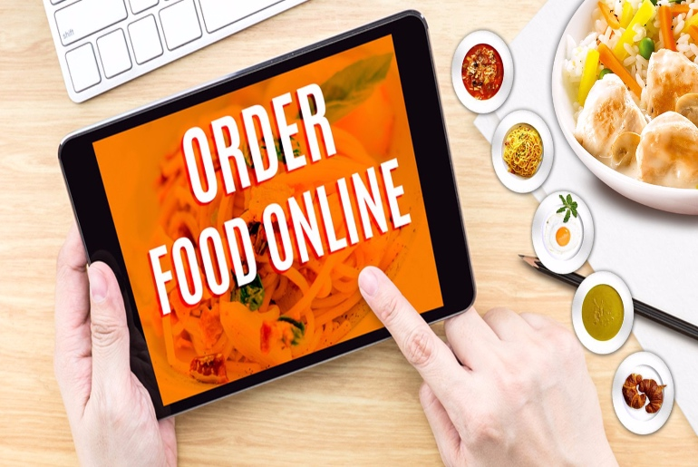
Solution Proposed
Reviews and feedback
Online Vegan food delivery system
Provides array of restaurants and meal options
Consumer
Restaurant
Browse menu options, order and pays
Accepts order
Assigns order
Feedback
Pick up the meal
Delivery Person
Delivers meal
Feedback and reviews

Slide 17
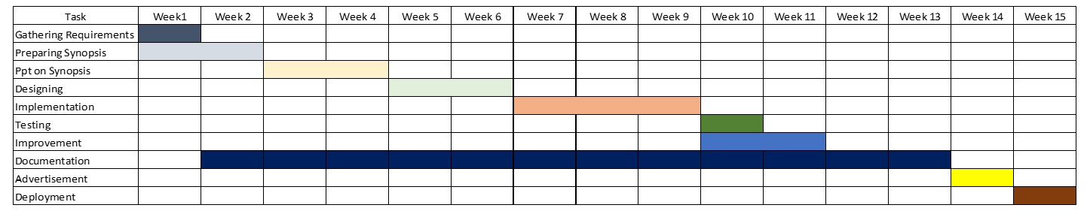
Planning OF Project

Slide 18
The Outcome Discussion
With the help of this system, people can easily order the food. It can also ensure that the people do not waste their precious time and user their time productively in the other works
This system proves to be more cost effective and reliable over other systems. It is very easy to use.

Slide 19
Conclusion
We have developed secure, user friendly food ordering Management System. This system can take care of each member whether it is an administrator or customer. System is completely secure since every user is provided with user id and password. So this system will provide more facility for Customer to like the services.

Slide 20
Limitations
Server capabilities
Our system won’t generate offline reports
Timelines
Threat of big players
Logistics Dilemma

Slide 21
Acknowledgment
First and foremost , we would like to express our sincere gratitude to our mentor Praveen sir for the continuous support , guidance and his immense knowledge.
Finally we would like to thank our team mates for all the support and encouragement during the project work.

Slide 22
Q&A

Slide 23
THANKS

